Slide 1

Notes:
Don’t use DOM API

Slide 2
Agenda
Component lifecycle
Handling events
Conditional rendering
Lists & keys
Forms
Styles

Slide 3
Component lifecycle
Can be used only in class components
Class methods that are called in a specific lifecycle moment of the component
class Clock extends React.Component {
constructor(props) { … }
componentDidMount() { // a lifecycle method
// do something when the component is mounted to the view
}
render() { … }
}

Slide 4
Lifecycle example - Stop Watch
Set a one second interval in the componentDidMount
Remove the time in the componentWillUnmount
Why - so the interval won’t run even though the component is no longer rendered
Notes:
Show the option to show renders in the react dev tools
Show the safe way to update the state with the previous value (time +1):
(oldState) => {
Return {time: oldState.time + 1}
}

Slide 5
setState with previous state
React docs:
State Updates May Be Asynchronous.
React may batch multiple setState() calls into a single update for performance.
Because this.props and this.state may be updated asynchronously, you should not rely on their values for calculating the next state.

Slide 6
setState with previous state
For example, this code may fail to update the counter:
// Wrong
this.setState({
counter: this.state.counter + this.props.increment,
});
To fix it, use a second form of setState() that accepts a function rather than an object. That function will receive the previous state as the first argument, and the props at the time the update is applied as the second argument:
// Correct
this.setState((state, props) => ({
counter: state.counter + props.increment
}));

Slide 7
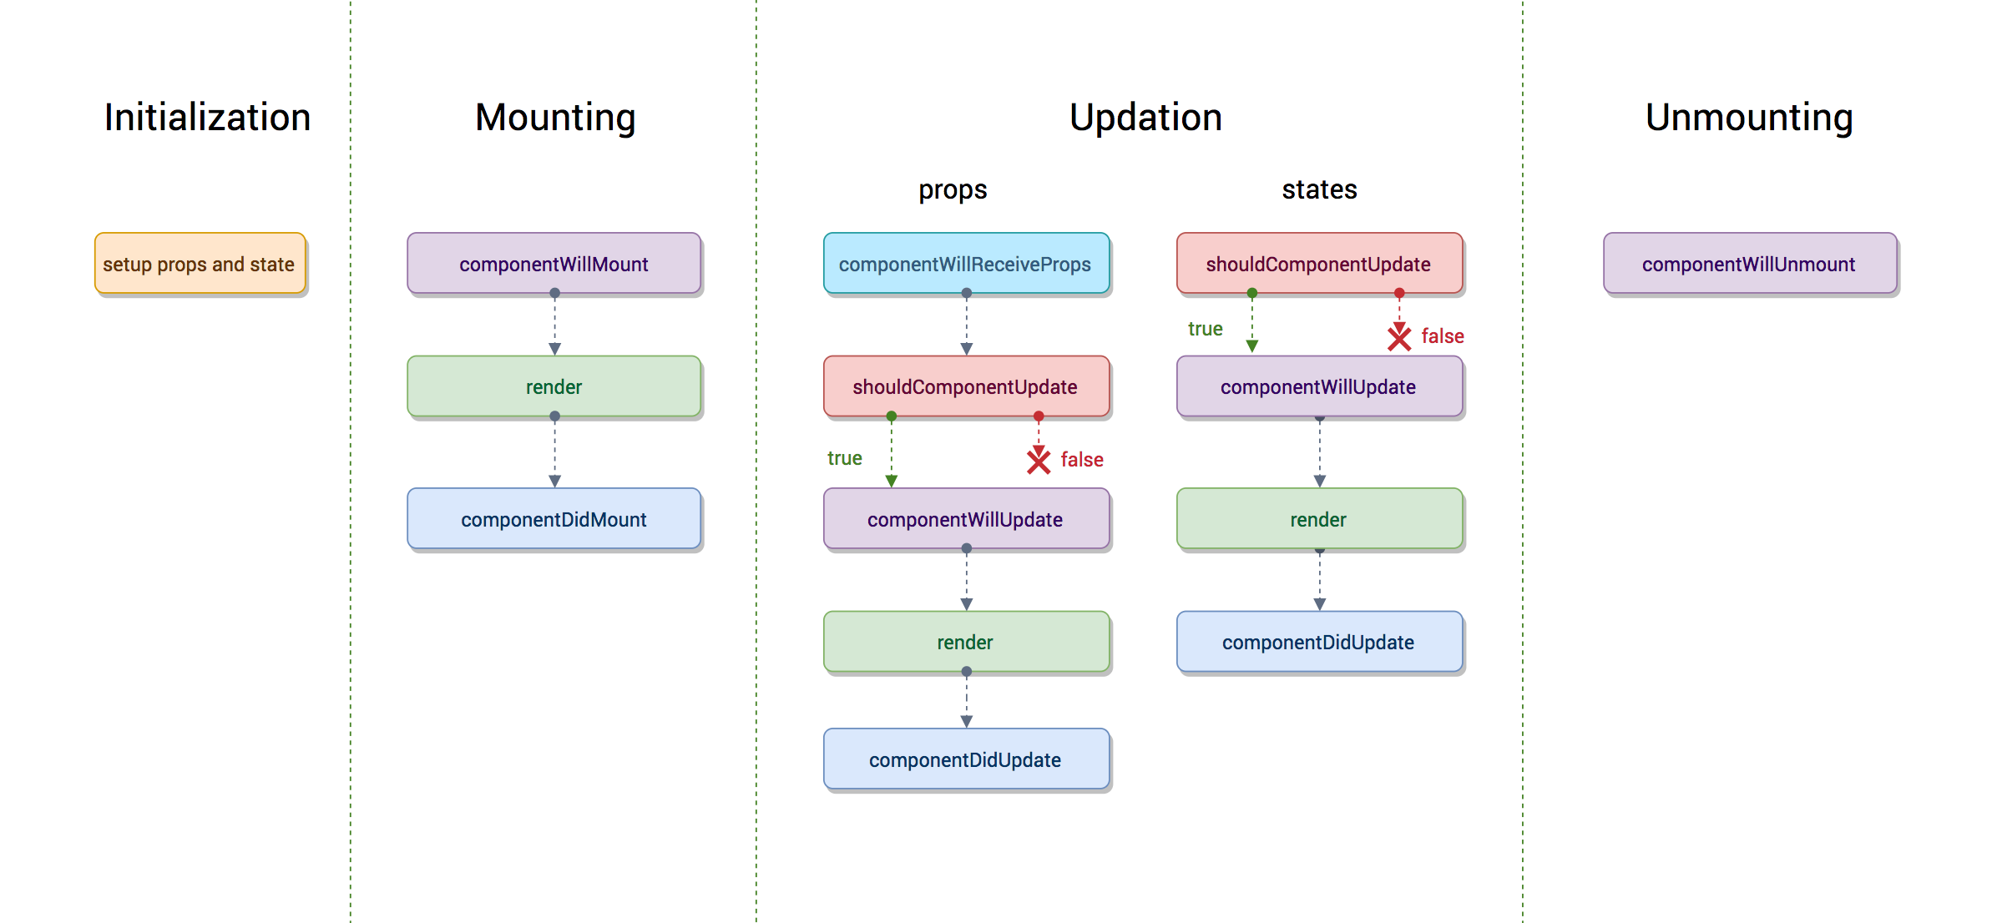
Component lifecycle chart

Slide 8
Handling events
Handle HTML events - camelCase (mind the binding)
Pass functions as props and call them in the component.

Slide 9
Handling events - HTML event
class MyComponent extends React.Component {
constructor(props) {
super(props);
this.state = {
myVar: 'value'
}
}
onButtonClick(event) {
console.log(this.state.myVar);
}
render() {
return <button onClick={(event) => this.onButtonClick(event)}></button>
}
}

Slide 10
Handling events - binding error
class MyComponent extends React.Component {
constructor(props) {
super(props);
this.state = {
myVar: 'value'
}
}
onButtonClick(event) {
console.log(this.state.myVar);
}
render() {
return <button onClick={this.onButtonClick}></button>
}
}
Won’t work. without the right binding, this.state won’t work properly (this won’t point to the class instance)
To fix this, either use an arrow function (like in the previous slide), or add binding: this.onButtonClick.bind(this)

Slide 11
Conditional rendering
E.g. if-else for components and elements rendering.
let elementToRender = <h1>Hi</h1>;
if (!isSomething) {
elementToRender = <h2>Bye</h2>;
}
return <div>
{elementToRender}
</div>
-------------------------------------------------------
return (
<div>
{isSomething && <h1>Hi</h1>}
{!isSomething && <h2>Bye</h2>}
</div>
)
return (
{isSomething ? (
<h1>Hi</h1>
) : (
<h2>Bye</h2>)}
)
--------------------------------------------------------
return (
<div>
<h1>{isSomething ? 'Hi' : 'Bye'}</h1>
</div>
)
Not recommended, code can become hard to read.
This is ok if used with primitive values, the code doesn’t get messy

Slide 12
Lists and Keys
Render arrays in the view - for loops in JSX
Add a unique key to each element - not it’s index!
This tells React what to re-render if the list changes.
const MyList = (props) => {
const someArray = [1, 2, 3, 4, 5, 6, 7, 8, 9];
return (
<ul>
{someArray.map(el => <li key={el}>{el}</li>) }
</ul>
)
}
const MyList = (props) => {
const someArray = [1, 2, 3, 4, 5, 6, 7, 8, 9];
const listToRender = someArray
.map(el => <li key={el}>{el}</li>);
return (
<ul>
{listToRender}
</ul>
)
}

Slide 13
Forms
To handle input info from HTML we will use a state - controlled component.
Example in the next slide.
Can be done also with hooks - https://reactjs.org/docs/hooks-intro.html

Slide 14
class FormComponent extends React.Component {
constructor(props) {
super(props);
this.state = {
name: '',
age: 0,
}
}
handleNameChange(event) {
this.setState({ name: event.target.value });
}
handleAgeChange(event) {
this.setState({ age: event.target.value });
}
handleSubmit(event) {
console.log(`The form was submitted with ${this.state}`);
event.preventDefault();
}
render() {
const { name, age } = this.state;
return (
<form onSubmit={event => this.handleSubmit(event)}>
<label>Name:</label>
<input
type="text"
value={name}
onChange={event => this.handleNameChange(event)}
/>
<label>Age:</label>
<input
type="number"
value={age}
onChange={event => this.handleAgeChange(event)}
/>
<input type="submit" value="Submit" />
</form>
);
}
}

Slide 15
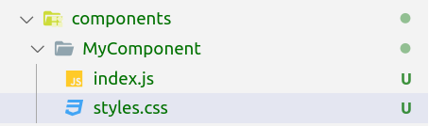
Including Styles
Can import CSS files to JSX using ES6 imports
import './styles.css';
Recommended folder structure for components
className - replaces class attribute in React

Slide 16
Debugging - React Dev Tools
Allow you to inspect components and play with their props and state
Chrome - https://chrome.google.com/webstore/detail/react-developer-tools/fmkadmapgofadopljbjfkapdkoienihi?hl=en
Firefox - https://addons.mozilla.org/en-US/firefox/addon/react-devtools/

